Slide 1
Machine Learning In PHYsics FoundationS 1
Harrison B. Prosper
PHY 6938 Fall 2024

Slide 2
Goals of this Course
Gain a good understanding of the mathematical basis of machine learning (ML).
Gain experience building ML models using PyTorch to solve data science problems in physics.
Gain experience with different ML models.
Gain an appreciation of the power of ML models as well as their (current) limitations.

Slide 3
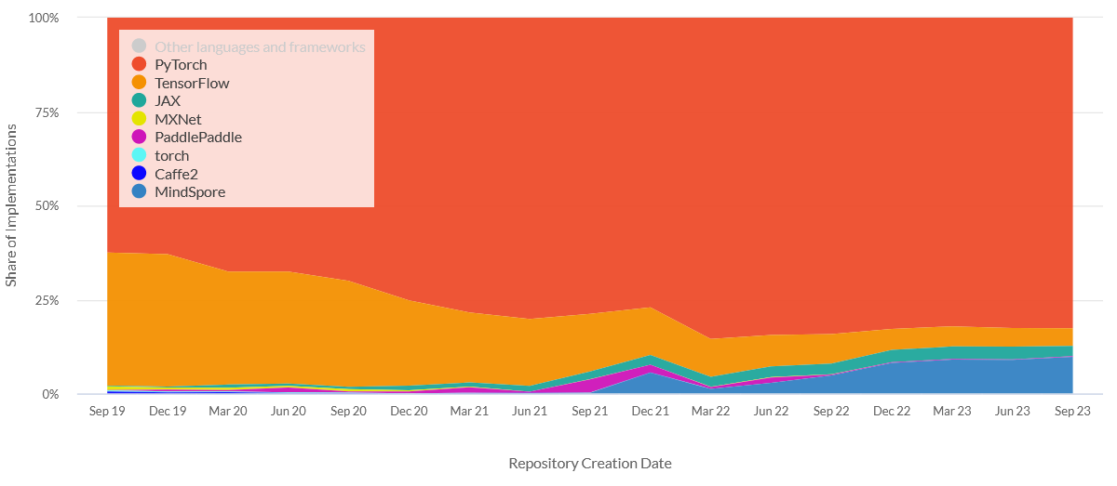
Why PyTorch?
https://viso.ai/deep-learning/pytorch-vs-tensorflow/

Slide 4
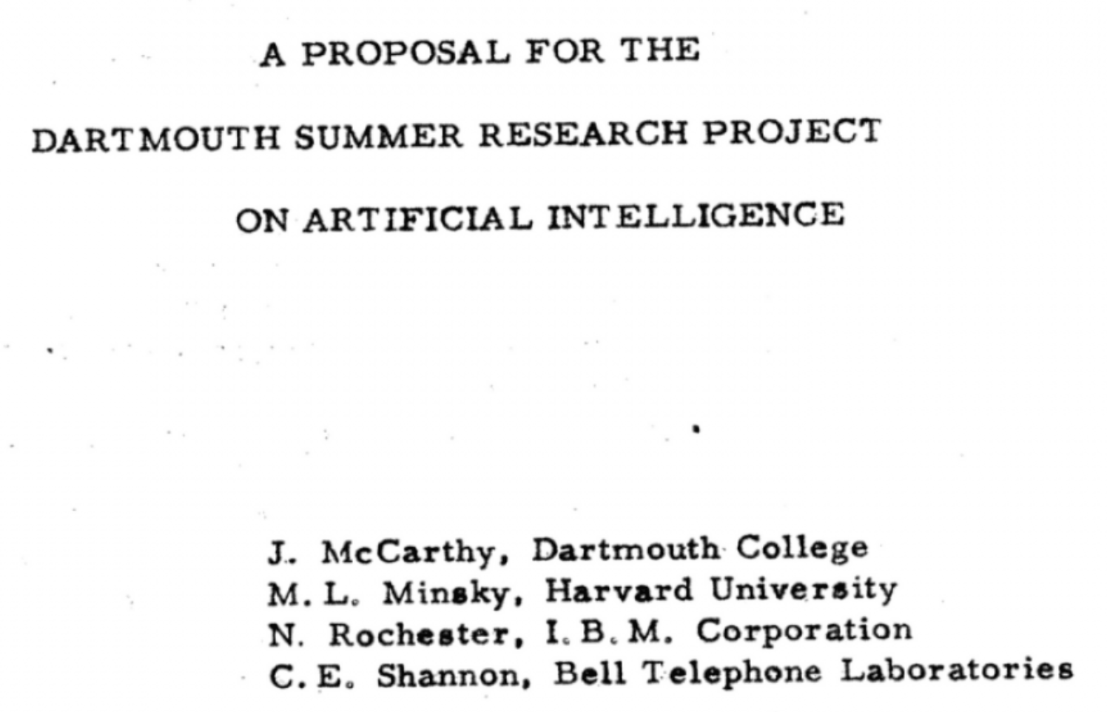
The Birth of Artificial Intelligence
1956

Slide 5
What is Artificial Intelligence?
Artificial Intelligence
Algorithms that cause machines to exhibit human- or superhuman-level intelligence.

Slide 6
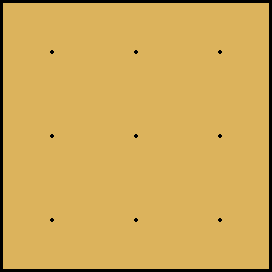
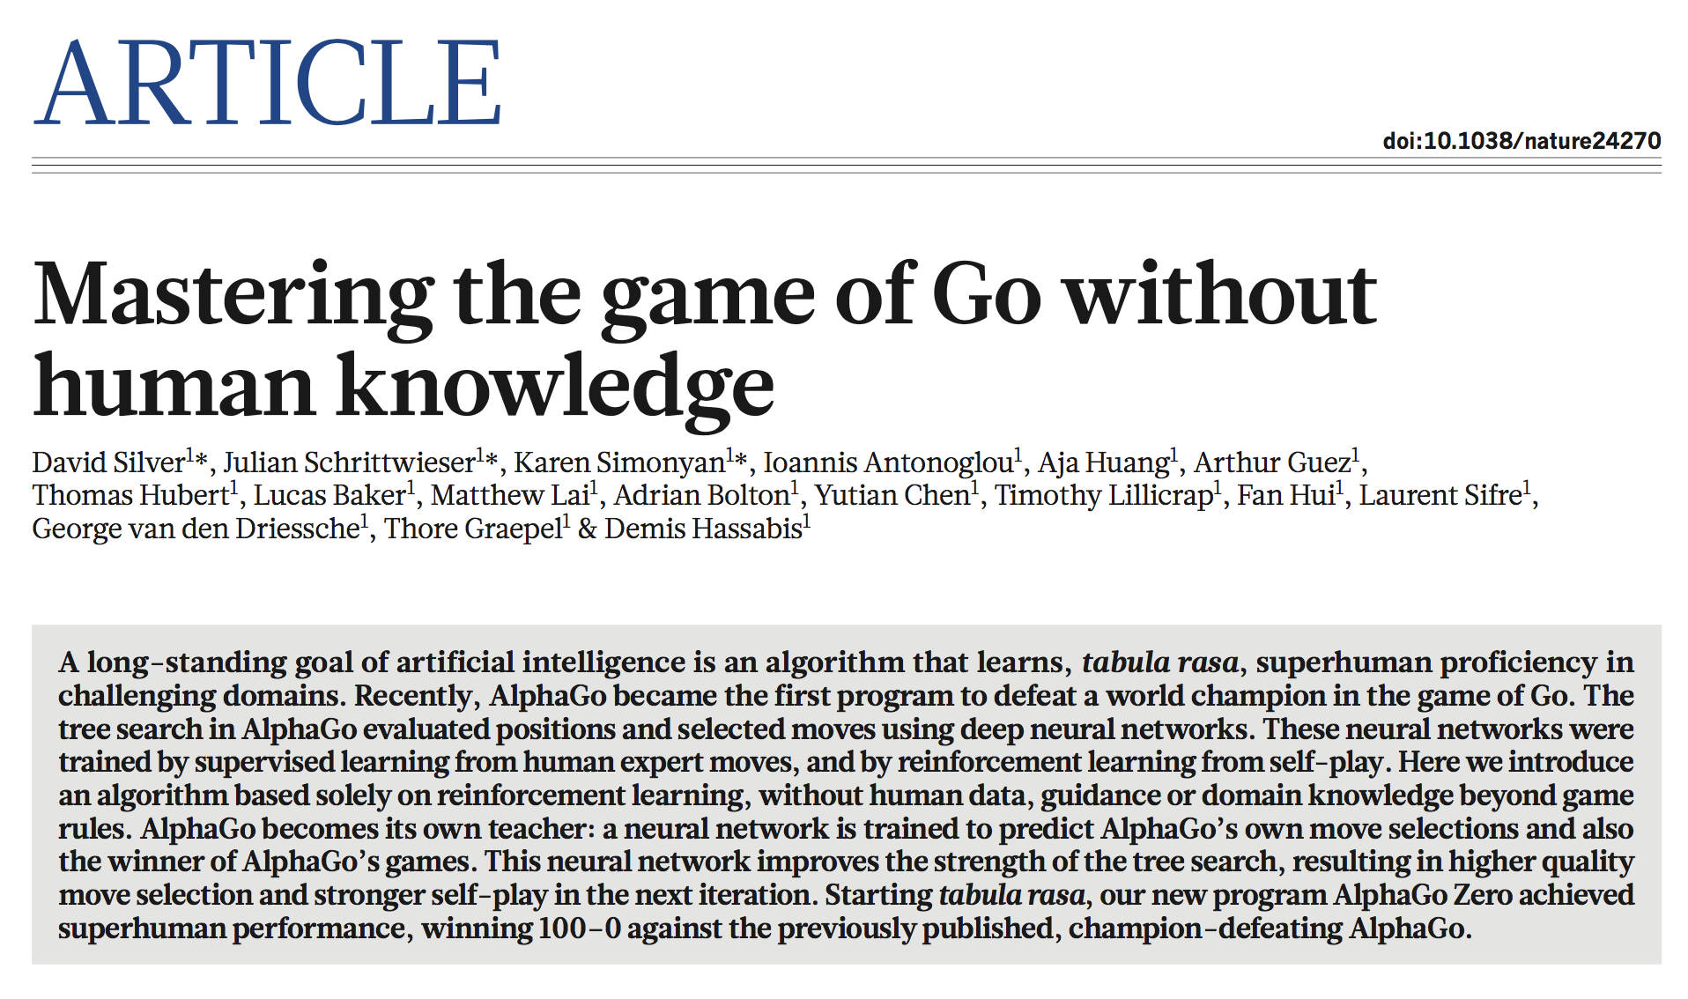
356 | NATURE | VOL 550 | 19 OCTOBER 2017

Slide 7
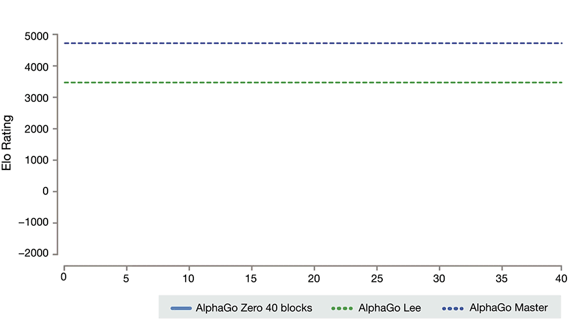
https://deepmind.com/blog/alphago-zero-learning-scratch/

Slide 8


Symbolic Mathematics
In December 2019, Guillaume Lample and François Charton* (Meta fka Facebook AI Research, Paris) claimed: “We achieve results that outperform commercial Computer Algebra Systems such as Matlab or Mathematica.”
* G. Lample and F. Charton, Deep Learning for Symbolic Mathematics, arXiv: 1912.01412v1
Lample
Charton

Slide 9
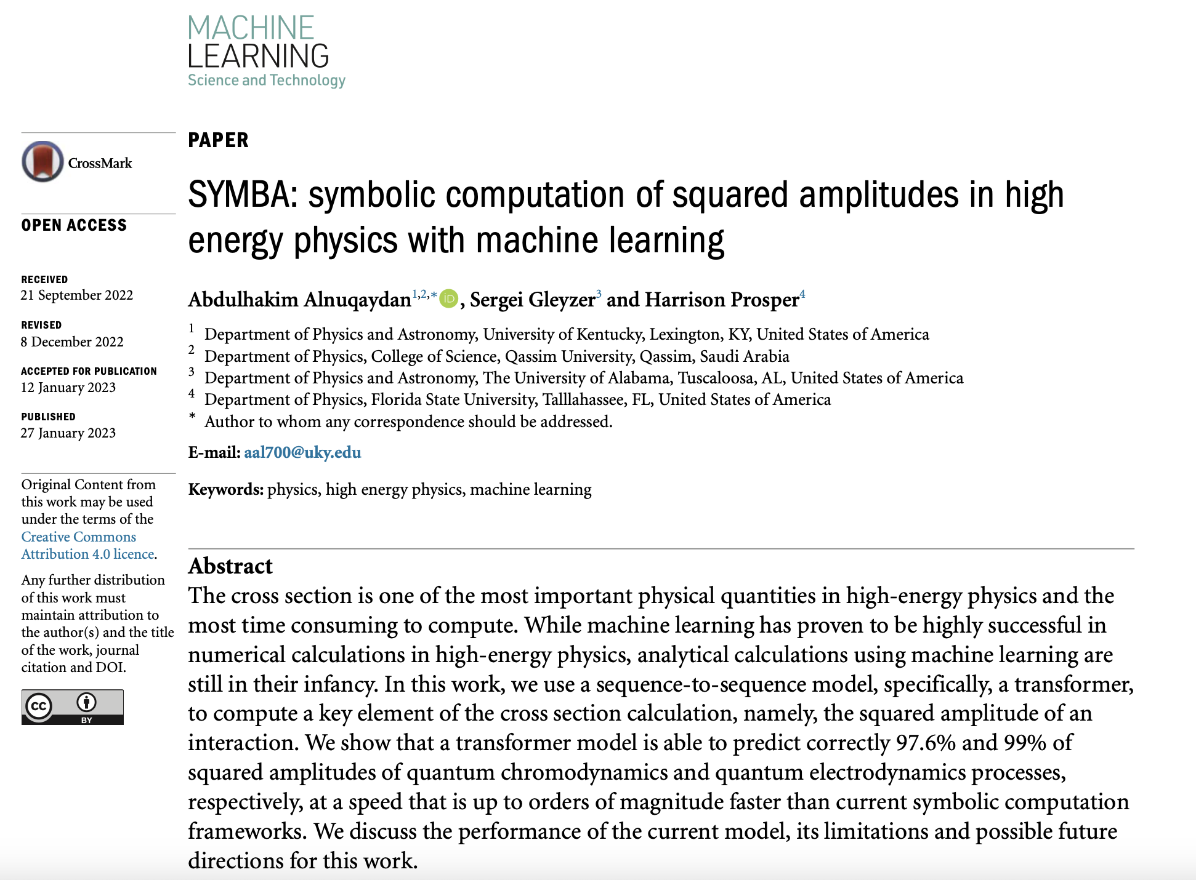

Slide 10
What is Machine Learning?
Artificial Intelligence
Algorithms that cause machines to exhibit human- or super-human level intelligence.
Machine Learning
Algorithms for modeling data.

Slide 11
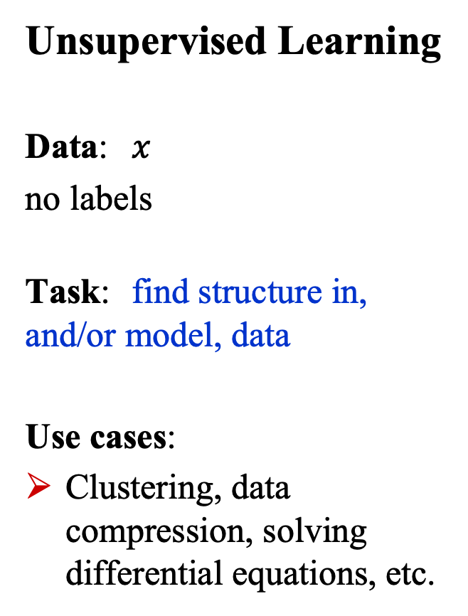
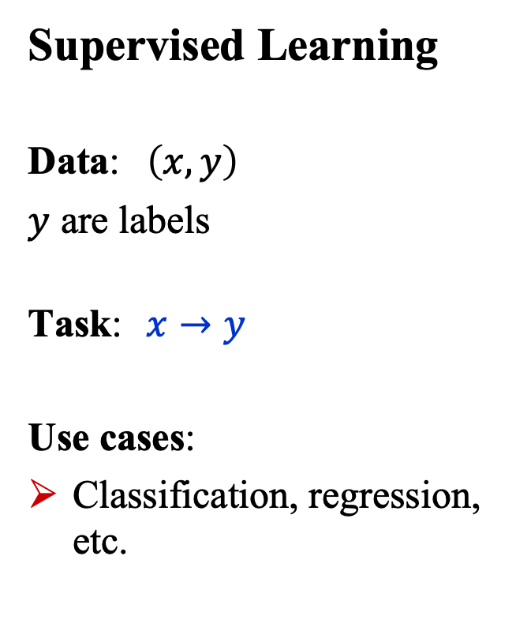
What is Machine Learning?
Supervised Learning
Data: $\left(x, y\right)$
$y$ are labels
Task: $x→y$
Use cases:
Classification, regression, etc.
Unsupervised Learning
Data: $x$
no labels
Task: find structure in, and/or model, data
Use cases:
Clustering, data compression, solving differential equations, etc.

Slide 12
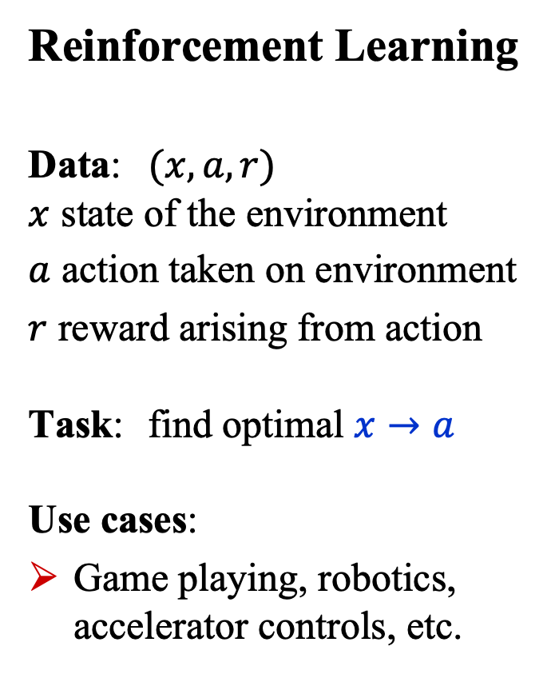
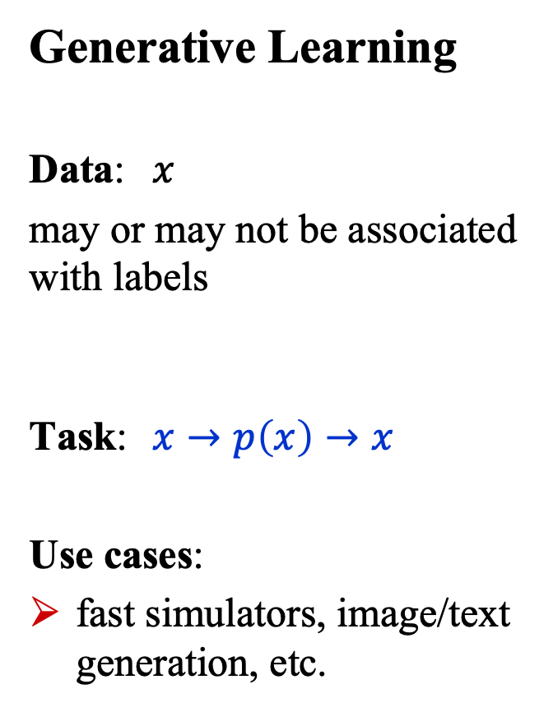
What is Machine Learning?
Generative Learning
Data: $x$
may or may not be associated with labels
Task: $x→p\left(x\right)→x$
Use cases:
fast simulators, image/text generation, etc.
Reinforcement Learning
Data: $(x,a,r)$ $x$ state of the environment
$a$ action taken on environment
$r$ reward arising from action Task: find optimal $x→a$ Use cases:
Game playing, robotics, accelerator controls, etc.

Slide 13
What is Deep Learning?
Artificial Intelligence
Algorithms that cause machines to exhibit human- or super-human-level intelligence.
Machine Learning
Algorithms for modeling data
Deep Learning
ML using (large) neural networks

Slide 14
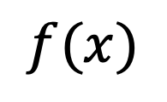
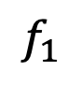
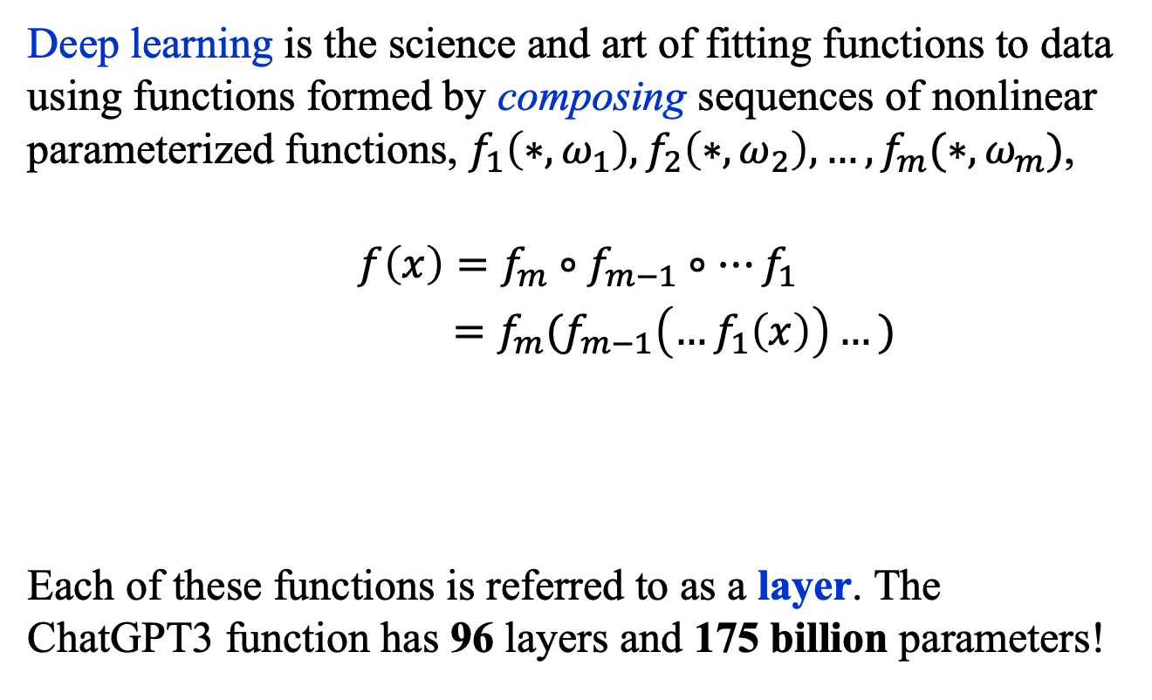
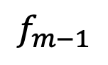
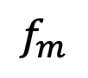
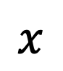
What is Deep Learning?
Deep learning is the science and art of fitting functions to data using functions formed by composing sequences of nonlinear parameterized functions, $f_{1}\left(∗, ω_{1}\right),f_{2}\left(∗,ω_{2}\right),…, f_{m}(∗,ω_{m})$,
$$f\left(x\right)=f_{m}∘f_{m−1}∘…f_{1}$$
$=f_{m}(f_{m−1}\left(…f_{1}\left(x\right)\right)…)$
Each of these functions is referred to as a layer. The ChatGPT3 function has 96 layers and 175 billion parameters!
$$f(x)$$
…
$$x$$
$$f_{m}$$
$$f_{m−1}$$
$$f_{1}$$

Slide 15
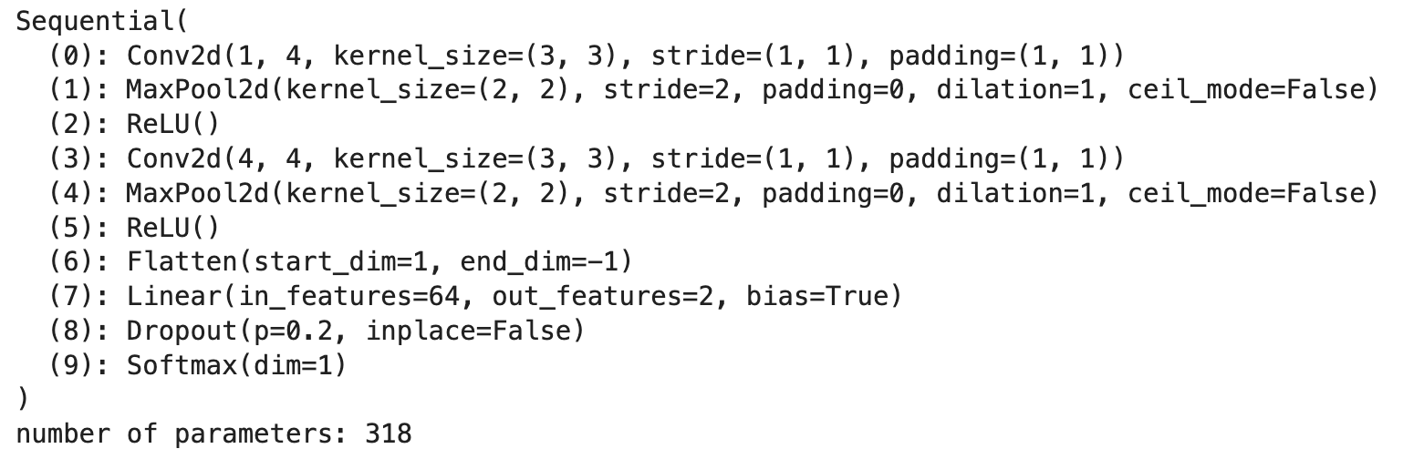
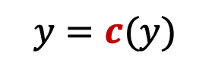
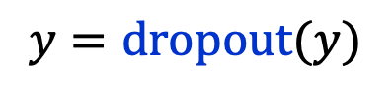
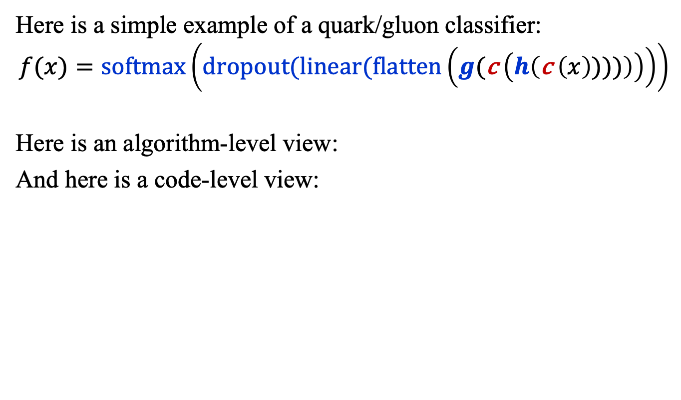
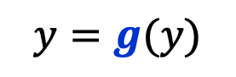
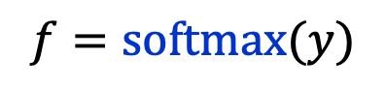
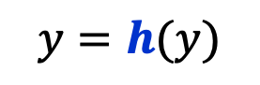
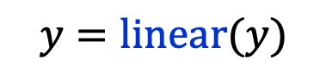
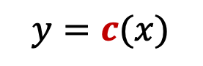
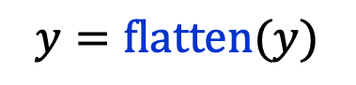
What is Deep Learning? Example
Here is a simple example of a quark/gluon classifier:
$$f(x)=\text{softmax}\left(dropout(linear(flatten\left(g(\text{c} \left(h\left(\text{c} \left(x\right))))\right)\right)\right)\right)$$
Here is an algorithm-level view:
And here is a code-level view:
$$y=c(x)$$
$$y=\text{flatten}(y)$$
$$y=h(y)$$
$$y=\text{linear}(y)$$
$$y=c(y)$$
$$y=\text{dropout}(y)$$
$$y=g(y)$$
$$f=\text{softmax}(y)$$

Slide 16
Basic building block: The perceptron

Slide 17
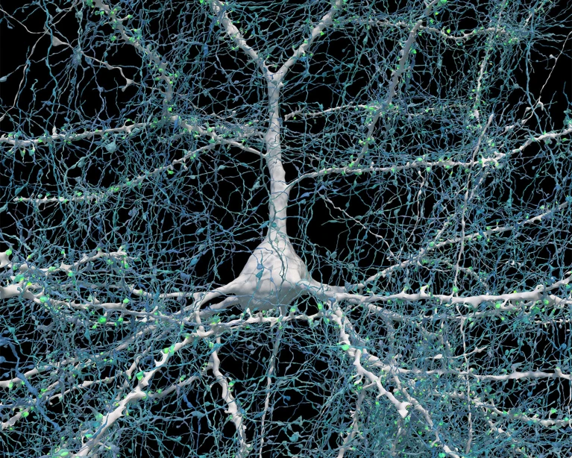
The Brain’s Computational Unit
https://www.nature.com/articles/d41586-024-01387-9

Slide 18
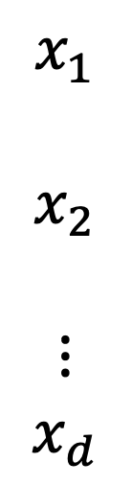
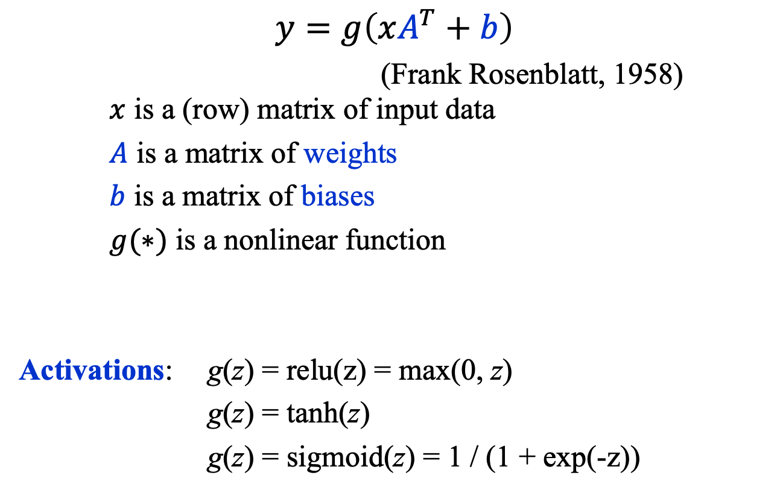

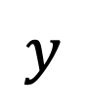
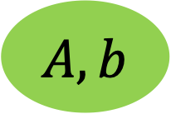
Artificial Comp. Unit: The Perceptron
$$y=g\left(xA^{T}+b\right)$$
(Frank Rosenblatt, 1958) $x$ is a (row) matrix of input data
$A$ is a matrix of weights
$b$ is a matrix of biases
$g(∗)$ is a nonlinear function
Activations: g(z) = relu(z) = max(0, z)
g(z) = tanh(z)
g(z) = sigmoid(z) = 1 / (1 + exp(-z))
$$x_{1}$$
$$x_{2}$$
$$⋮$$
$$x_{d}$$
$$y$$
$$g$$
$$A, b$$
https://news.cornell.edu/stories/2019/09/professors-perceptron-paved-way-ai-60-years-too-soon

Slide 19
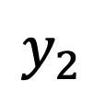
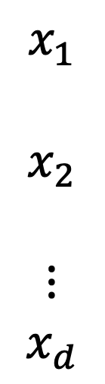
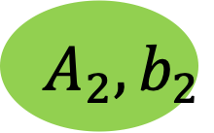
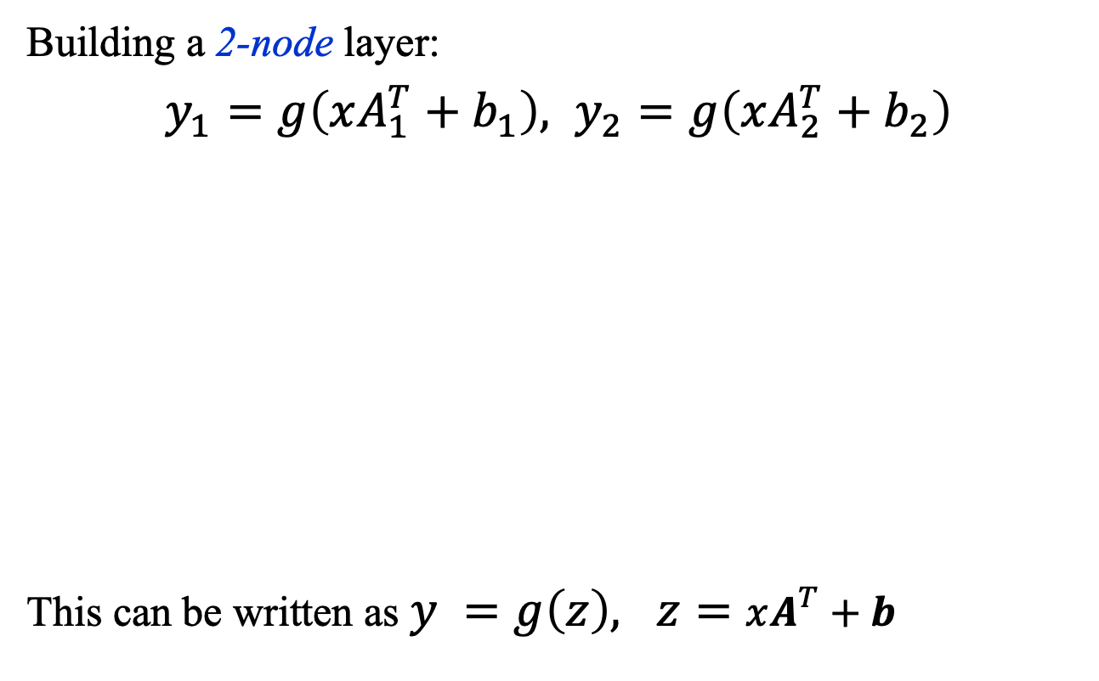

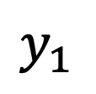
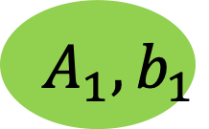

Artificial Comp. Unit: The Perceptron
Building a 2-node layer:
$y_{1}=g\left(xA_{1}^{T}+b_{1}\right), y_{2}=g\left(xA_{2}^{T}+b_{2}\right)$
This can be written as $y =g\left(z\right), z=xA^{T}+b$
$$x_{1}$$
$$x_{2}$$
$$⋮$$
$$x_{d}$$
$$y_{1}$$
$$g$$
$$A_{1}, b_{1}$$
$$y_{2}$$
$$g$$
$$A_{2}, b_{2}$$

Slide 20
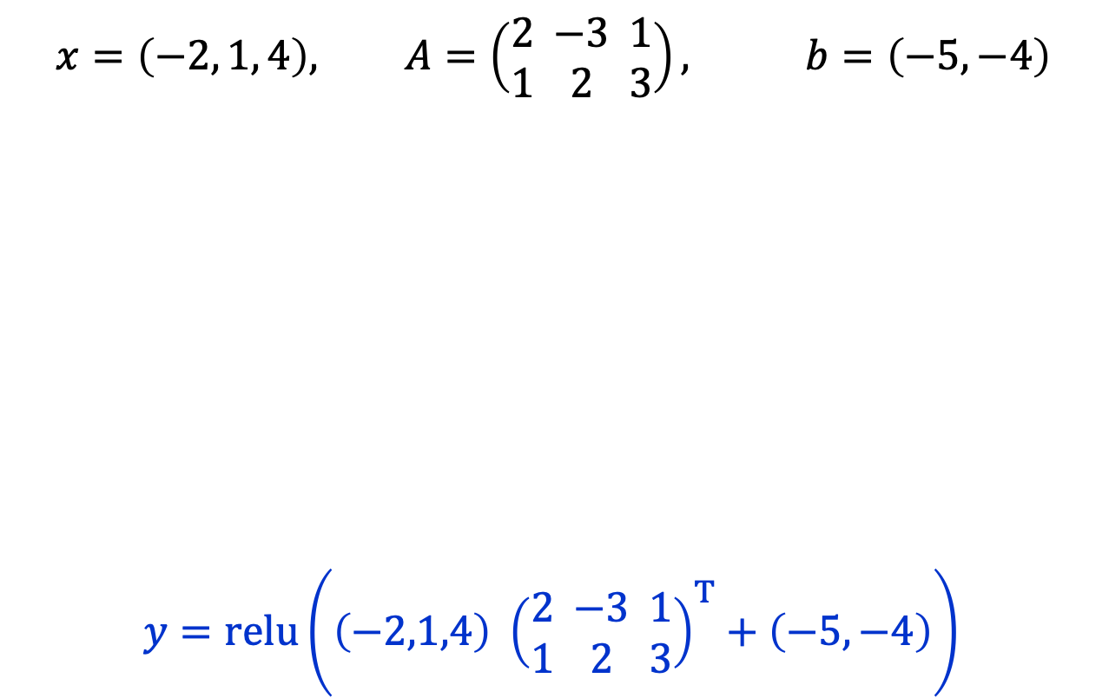
The Perceptron: Example
$$x=\left(−2, 1, 4\right), A=\left(\begin{matrix}2 \\ 1\end{matrix}\begin{matrix} −3 \\ 2\end{matrix}\begin{matrix}1 \\ 3\end{matrix}\right), b=\left(−5,−4\right)$$
$y=\text{relu}\left(\left(−2,1,4\right) {\left(\begin{matrix}2 \\ 1\end{matrix}\begin{matrix} −3 \\ 2\end{matrix}\begin{matrix}1 \\ 3\end{matrix}\right)}^{T}+\left(−5,−4\right)\right)$
$$x_{1}$$
$$x_{2}$$
$$⋮$$
$$x_{d}$$
$$y_{1}$$
$$g$$
$$A_{1}, b_{1}$$
$$y_{2}$$
$$g$$
$$A_{2}, b_{2}$$

Slide 21
Summary
General Approaches
Supervised, unsupervised, generative, and reinforcement learning.
Deep Learning
Uses functions constructed through deep composition.
The Perceptron
Basic computational unit: matrix multiplication and addition and (typically) an element-wise nonlinear map.

